Slide 1

Acceleration of LRCN Networks on a FPGA
Matthew Portnoy, Hrushikesh Patil
Department of Electrical and Computer Engineering
Stony Brook University, Stony Brook, NY, USA
{matthew.portnoy, hrushikesh.patil}@stonybrook.edu

Slide 2
Goal
We plan to accelerate an LRCN network by using an FPGA.
The motivation for this work is to understand how FPGAs can make LRCNs applicable in a real time scenario.
To evaluate a video with 28 frames takes 0.5 seconds on NViDIA K80 GPU.
Such GPUs are not available on self driving cars and other low power embedded systems and hence real time applications are difficult.
We plan to evaluate the feasibility of FPGAs in computing the LRCN networks.

Slide 3
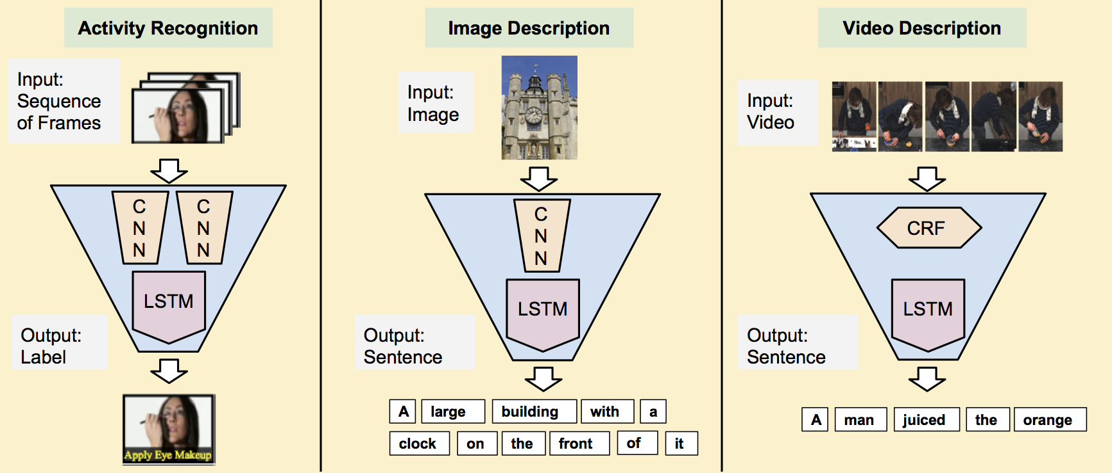
Overview of LRCN networks
LRCN stands for Long Term Recurrent Convolution Network.
It is specifically designed to process data that is spatio-temporal in nature
It is a combination of Convolutional Network and a LSTM network.
Applications include – Video classification, Image captioning, video captioning etc
Image from http://jeffdonahue.com/lrcn/

Slide 4
Design
First, we took a pre-trained LRCN network on UCF101 dataset.
Then, we extracted the weights of the LSTM layer, and transferred it to the DRAM of the FPGA.
Then we designed the architecture for 1 layer of LSTM on an FPGA.
The FPGA does calculations to receive outputs that is sent back to the main processor. This process is done until there is a least amount of error, and therefore the data is accelerated.

Slide 5

Implementation - Software
In software implementation we have a pretrained model of LRCN.
The LRCN in question is a combination of Resnet152 CNN and LSTM network.
We have used PyTorch to evaluate the LRCN.
The input to the LRCN network is the videos from the UCF101 dataset. The videos are shaped as (t-dim, channels, x-dim, y-dim) = (28, 3, 224, 224).
Where 28 is the no of frames of the video, 3 is the number of channels (RGB) in each frame and 224x224 pixels is the size of each individual frame.
This is done to match the input size ResNet152 which is tensors of size (3, 224, 224).

Slide 6
Implementation - Software
The software evaluation is divided into parts.
1. Computing the CNN outputs
2. Computation of LSTM output
3. FCN evaluations
The CNN computes the spatial features from each frame and outputs a vector of length 512 for each frame. The python script evaluates the spatial features for each frame and hence after evaluations of each frame we have the output as a tensor of size (28, 512).
The output of CNN is given to LSTM network. The LSTM network is followed by a Fully Connected Layer (FCN) which has 101 outputs.

Slide 7
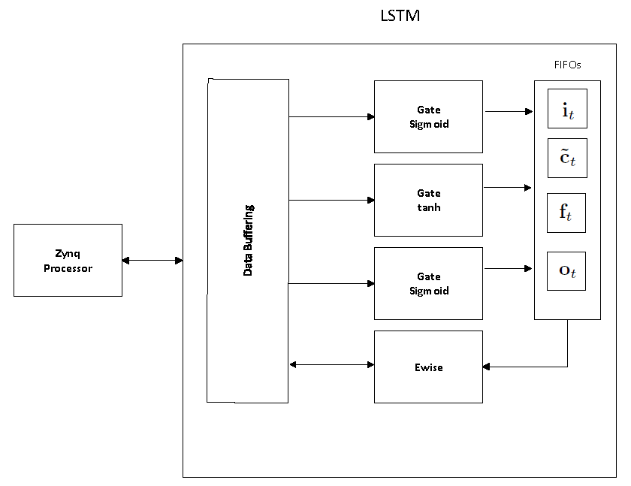
Implementation - Hardware
The LSTM module has three gate blocks. The gates are pre-configured to have a non-linear function (tanh or sigmoid).
There are three stages to our LSTM module and those are :
1) Compute it and ~ct.
2) Compute ft and ot.
3) Compute ct and ht.
In the first and second stage, three gate modules (8 MAC units) are running in parallel to generate the internal vectors (it, ~ct, ft and ot), which are stored into a FIFO for the next stages.
For the final stage we created an ewise module that consumes the FIFO vectors to output the ht and ct back to main memory.

Slide 8
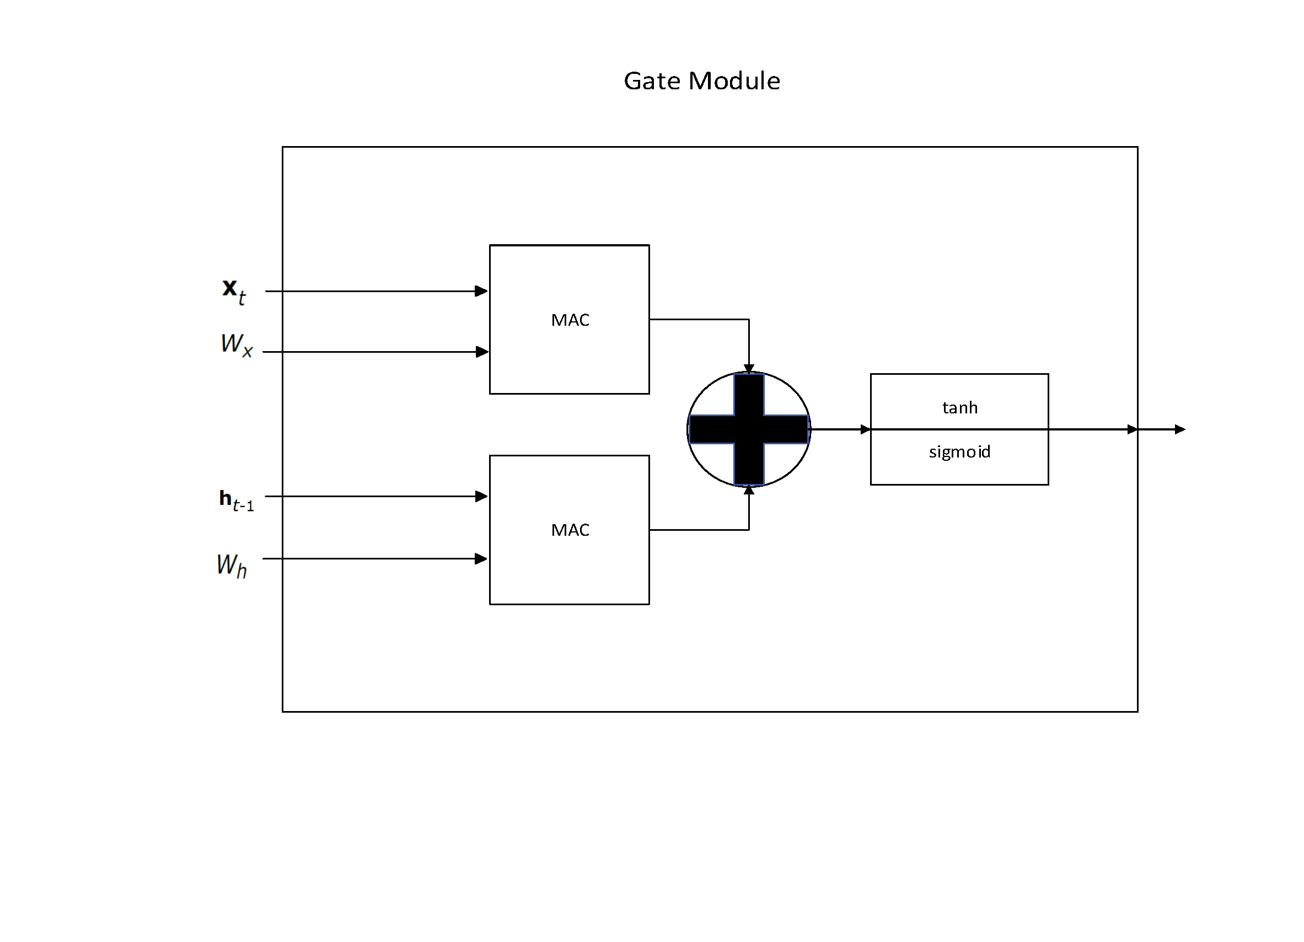
Implementation - Hardware
Our gate module comprises of 2 MAC units, an adder, and a sigmoid/tanh block.
Our MAC takes in a vector stream and weight matrix row stream. The same vector stream is multiplied and accumulated with each weight matrix row to produce an output vector with same size of the weight’s height.
The bias b can be added in the multiply accumulate by adding the bias vector to the last column of the weight matrix.
The results from the MAC units are added together.
The adder’s output goes to our sigmoid/tanh block, which is an element wise non-linear function.

Slide 9
Implementation - Hardware
The non-linear function is segmented into lines y = ax+b, with x limited to a particular range c0, c1.
Each line segment is implemented with a MAC unit.
The MAC multiplies a and x and accumulates with b.
The comparison between the input value and is within the line range a decision is made to process the input or pass it to the next line segment module.
For negative values we took an absolute value when being compared to the range.
This algorithm is similar for sigmoid and tanh. And in our gate module it chooses between the two.

Slide 10
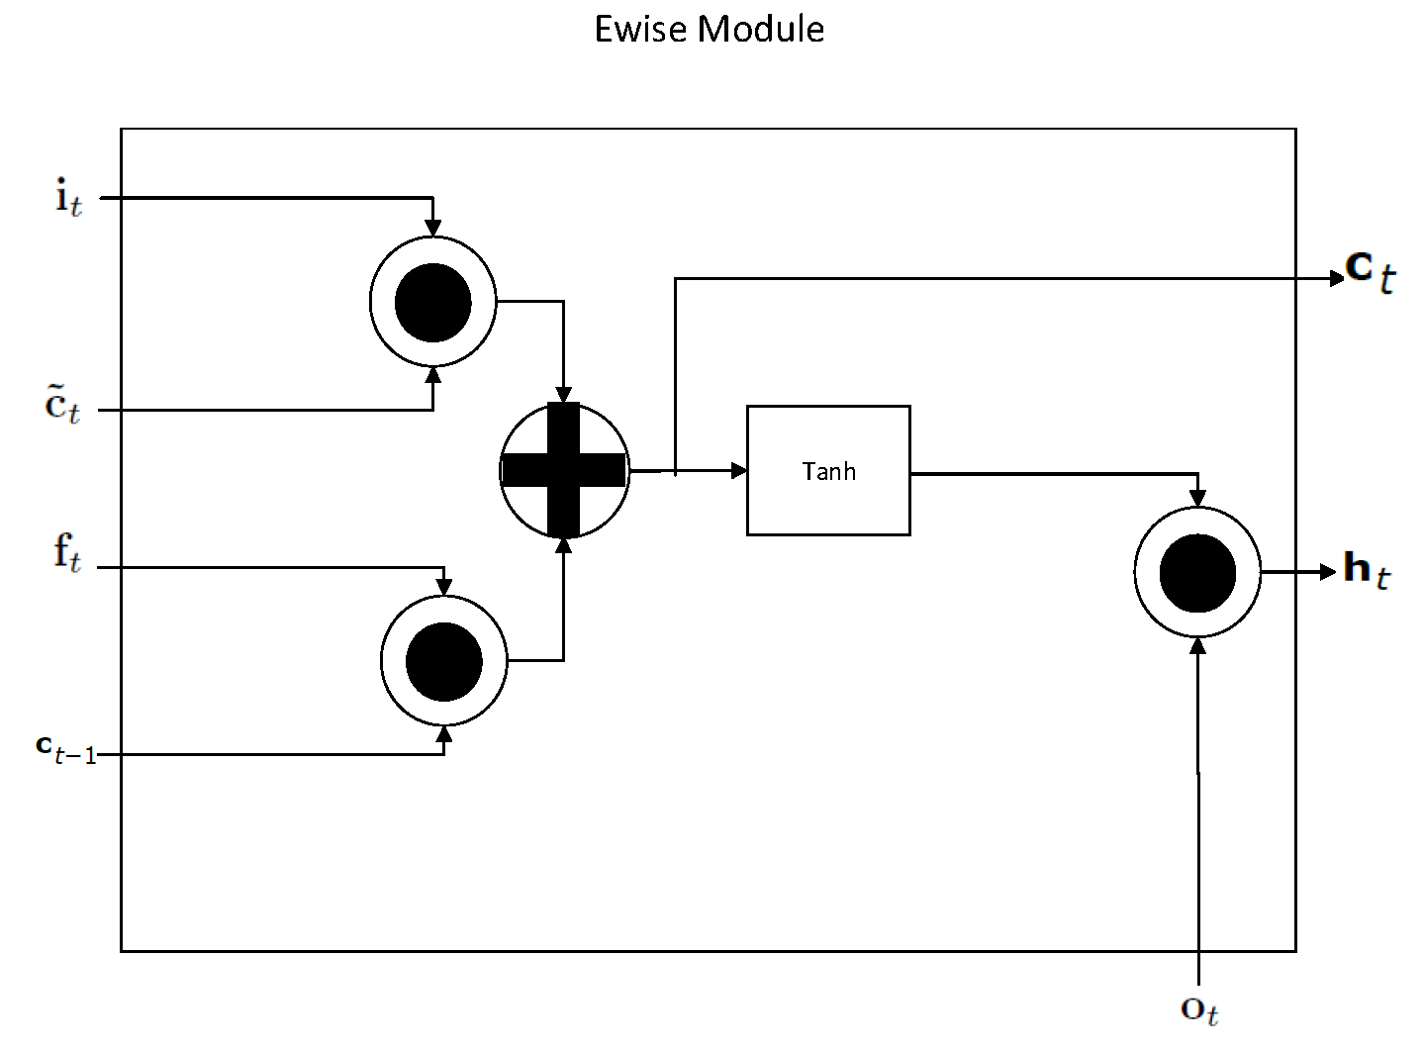
Implementation - Hardware
We created an ewise module that consumes the FIFO vectors to output the ht and ct back to main memory.
Our gate module consists of 3 element-wise multipliers, an adder, and a tanh block

Slide 11
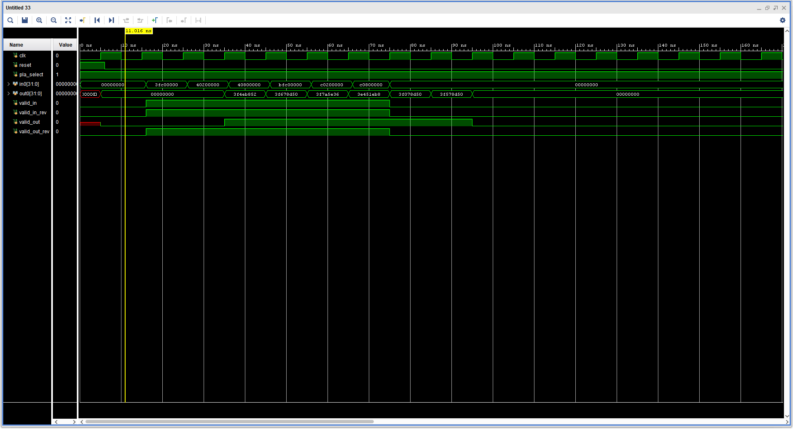
Results
Our sigmoid module with 6 inputs of x.
There were 2 ranges c0,c1
c0=1.67, c1=3.33
So three possibilities x<c0, c0<x<c1, and x>c1
Y = mx+ b
X= 1.5,2.5,4 ,-1.5,-2.5,-4
m0 = 0.205, m1 = 0.075, m2 = 0.017
b0 = 0.5, b1 = 0.717, b2 = 0.91
Outputs = 0.8075, 0.9045, 0.978, 0.192, 0.5295,
0.649

Slide 12
Results

Slide 13
Conclusion and Future Work
The performance of FPGA in accelerating the LSTM is directly dependent on memory. Since we are only able to fit 115 vectors of length 512 in BRAM the acceleration is hindered by the constant fetching of data from PS to PL.
The combined acceleration of CNN and LSTM will require massive amount of memory to be faster than GPUs.
Future work will be in full implementation of Gate module and EWISE module.
Architecture of CNN + LSTM in hardware.

